Slide 1
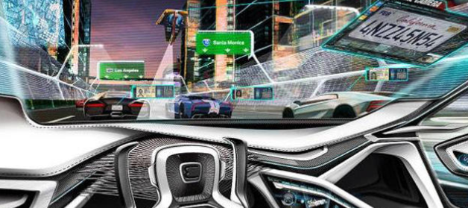

Autonomous Agent using Deep Reinforcement Learning
Gal Inbar - 302569496
Eliav Shalelashvili - 318466513
Shay Dondik - 316607902
Carla Environment

Slide 2
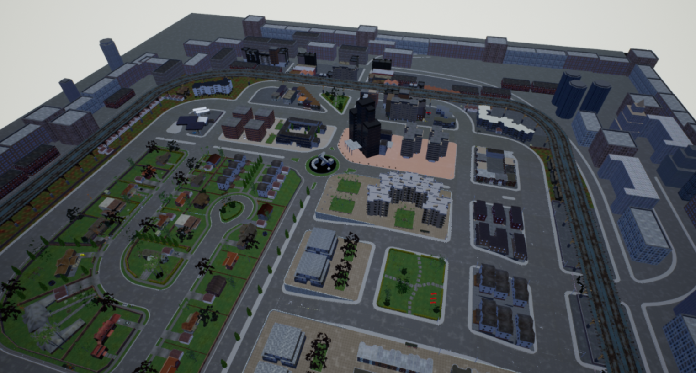
Carla
Simulation framework that support development, training, and validation of autonomous driving systems
Highlighted features
Flexible API
Autonomous Driving sensor suite
Fast simulation for planning and control
Maps generation
Traffic scenarios simulation
Autonomous Driving baselines
https://carla.readthedocs.io/en/latest/#getting-started

Slide 3
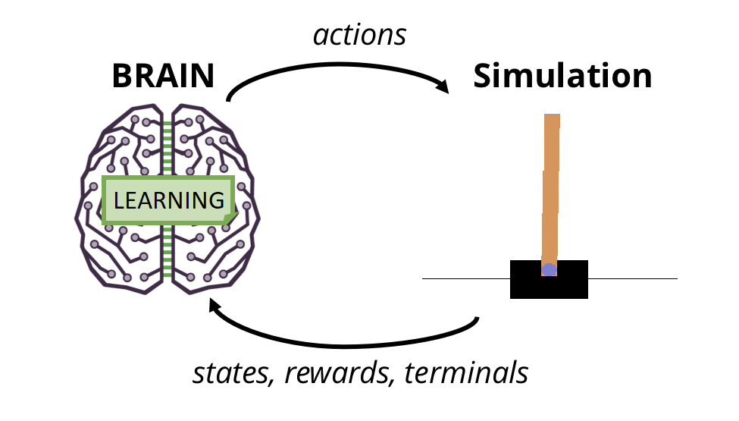
Reinforcement learning algorithms
DDQN
Prove convergence to some policy
DDQN + safety
Prove the usefulness of safety concept the article propose

Slide 4
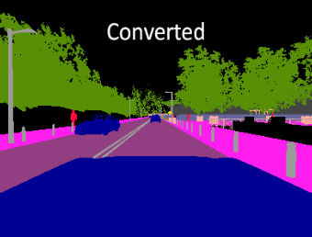
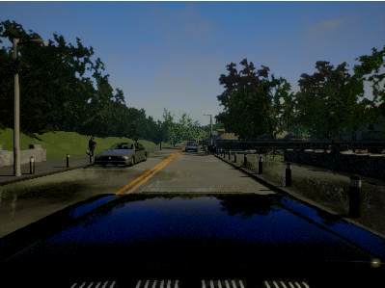
SNEAK PEEK sensor.camera.rgb
sensor.camera.semantic_segmentation
The "RGB" camera acts as a regular camera capturing images from the scene.

Slide 5
01
Learning Phase
Code Demo

Slide 6
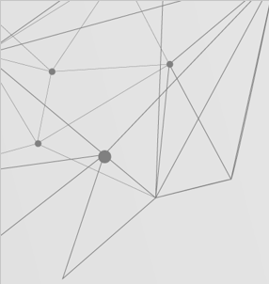
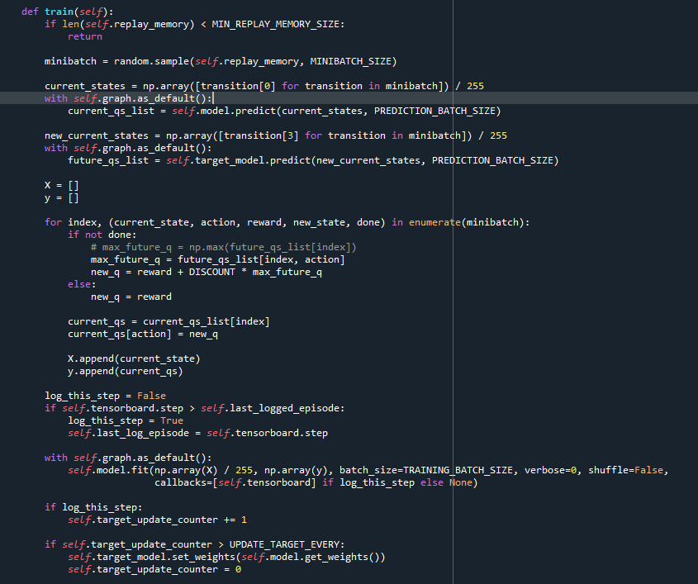
Train function
Replay memory– use a uniform sample from the replay memory, if there is not enough for a minibatch then don’t train
Q-values– get the current state and apply on it the online network, same goes for target network and the next state
New Q-value– we get our q-value from target network, then we update the target q-value called new_q
Target lists– X and y lists comprise the state and the target q-value respectively
Log_this_step – if we made a progressive step, through a check via Tensorboard, then update the steps taken
Fit model – after getting X and y lists, we can back propagate our model and correct it a little bit more
Target update– we count every logged step. When we get X amount of steps we copy the online network to the target network, the rese the counter again

Slide 7
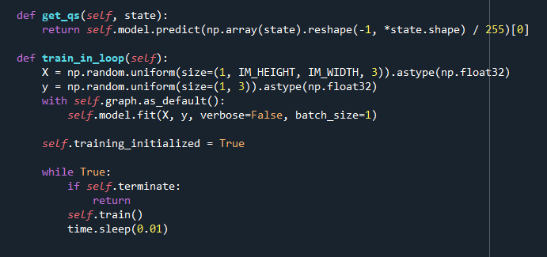
Train in loop
Get q_s – in order to get our prediction vector in the format we can use, we reshape it as follows
Fist fit – Tensorflow tends to fit the model for the first time very slowely, therefor we going to take a random data to fit
Fit model – after getting X and y lists, we can back propagate our model
Intialize training– we will keep training our model as long as it is not terminated for reasons we will see later

Slide 8
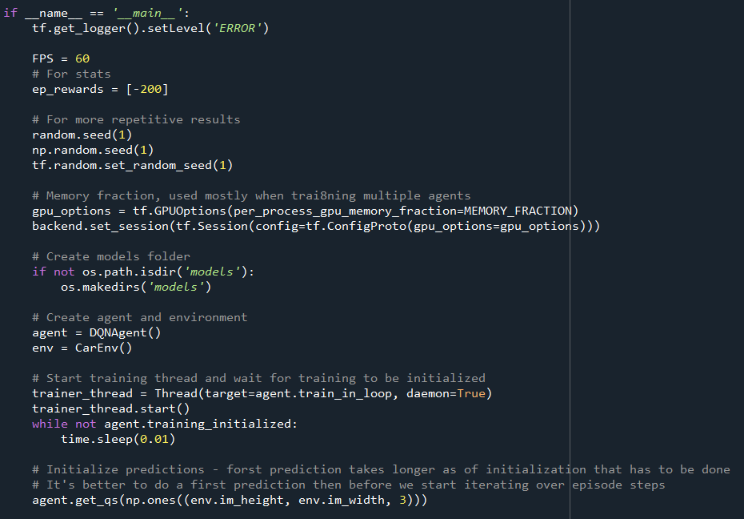
Initialization
Wanted frames per second – for synchronized data collection and computation time
Reward initialization – a big penalty for collision
Set seed– for repetitive results
Tensorflow, numpy and random libraries - all have their separate random seeds
GPU memory allocation – Tensorflow tends to use all of the GPU, therefor we need to allocate enough memory to run our model and the environment together
Threading – running a parallel program
Flag – when the train_in_loop raises a flag, give the program time to recover
First prediction– Because the first run of the network has initialization in it, it takes more time to output a prediction

Slide 9
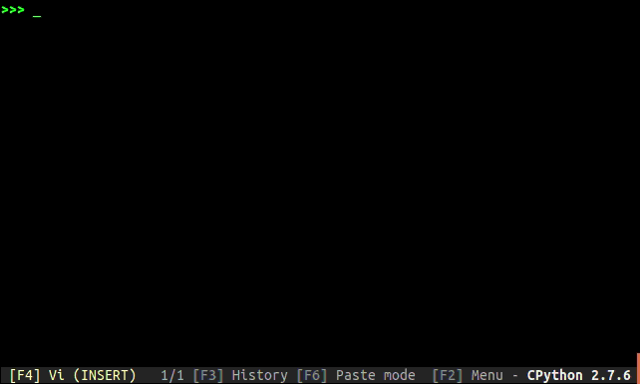
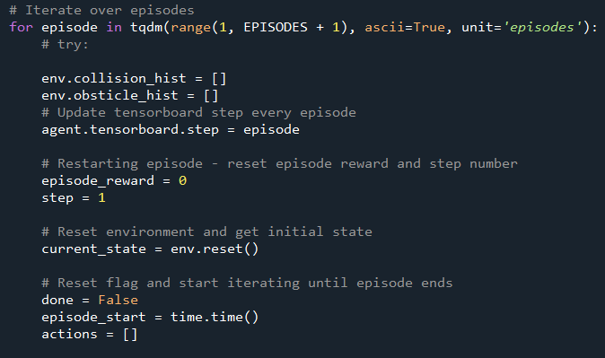
Iterate over episodes
Tqdm– a python library for a smart progress meter attached to iterable variable
History lists – reset collision history. History is collected via the agent’s sensors.
Same rule applies to the obstacles history.
Tensorboard step– If not updated, Tensorboard will consider every step to be every image taken by the agent, which is not our intention
initialization– further init’ for cumulative reward per episode and number of steps taken within the episode.
We start with current_state as the agent’s first placement within the Carla simulation
Episode Flag– we will iterate through the episode until the ‘done’ flag changes to ‘true’

Slide 10
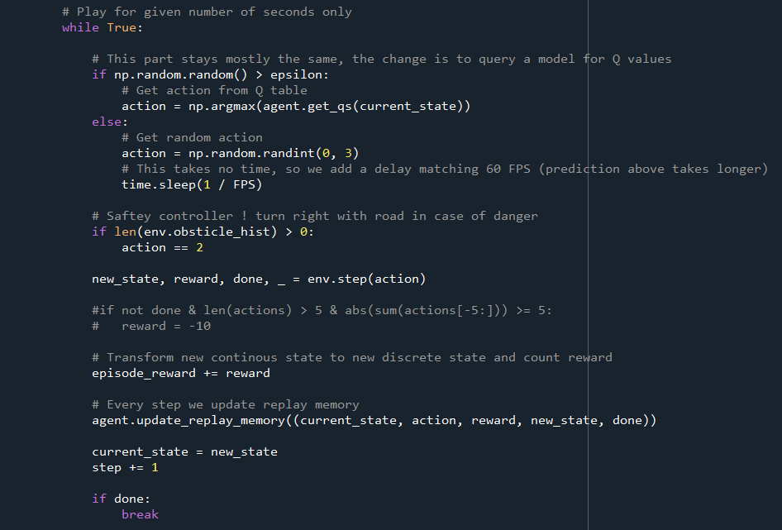
Iterate through an episode
Epsilon greedy – if we go greedy, our action to take is the max q value from the q netwrok.
Otherwise we go random.
Syncronization– taking a random action is almost instant in compare to a q network evaluation. There for we need to synchronize
Safety controller– if obstacle history is not empty, we choose tot take a right turn , just in case , to avoid danger
Taking action– after choosing a potential action, we actually make our agent to take the action in the env’, and we save the next position, the reward given and if collided or not
Updates– we update our cum’ episodic reward, out replay memory list ,our current state and step counter
Episode Flag– if we collided , done flag turns to ‘true’ we end the episode and start a new one

Slide 11
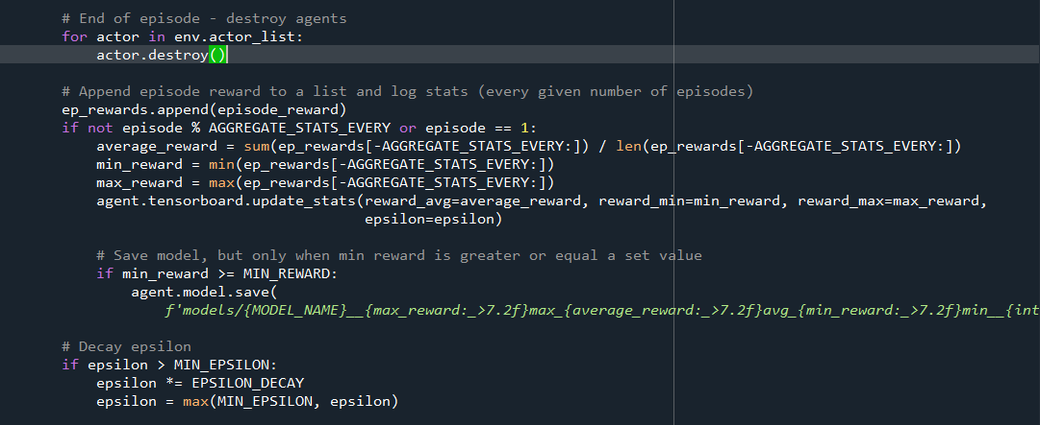
Episodes statistics
Actor temination– every actor we’ve added along our episode is erased.
Stats aggregation– we aggregate stats for every X amount of episodes to show on our Tensorboard
Stats– we basically show : average reward for that X amount of episodes , min reward given and max reward.
Then we just update Tensorboard
Model save– if our model happens to reach a min reward that we coded ahead, we save it for further analysis
Epsilon decay– to keep the exploration vs exploitation tradeoff , we decay our epsilon random variable by some percentage

Slide 12
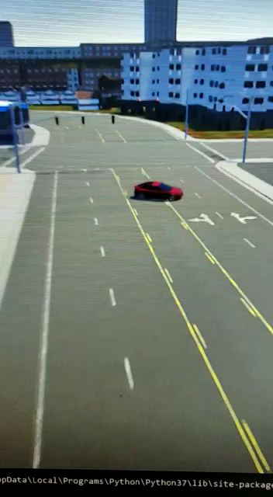
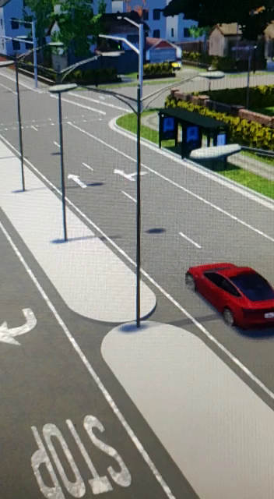
Video Time!
Run 1
Changing Network to
Xception
Run 2

Slide 13
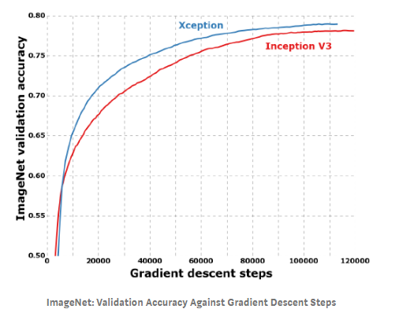
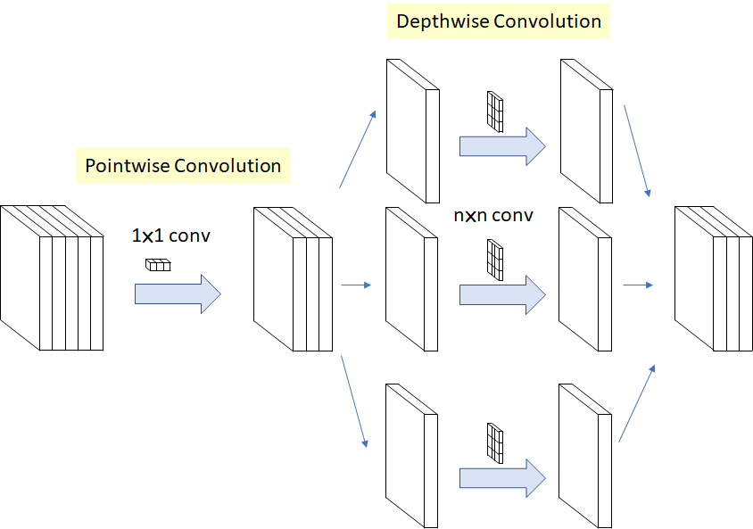
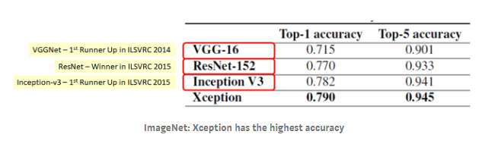
Xception
IN DEPTH
SeparableConv is the modified depthwise separable convolution.
Xception outperforms VGGNet [4], ResNet [3], and Inception-v3

Slide 14
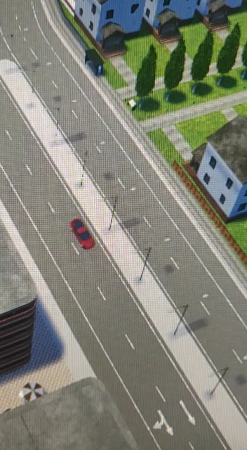
Video Time!
Run 3 + sensor “lane invasion”

Slide 15
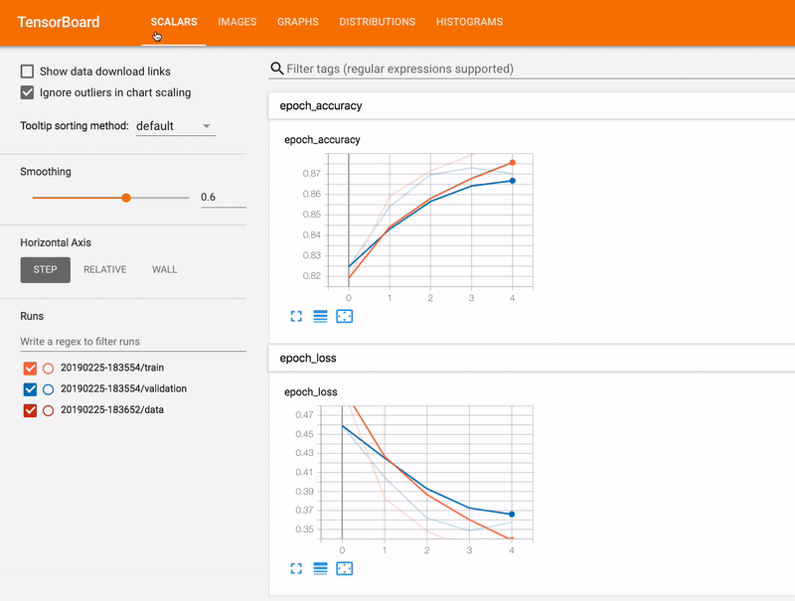
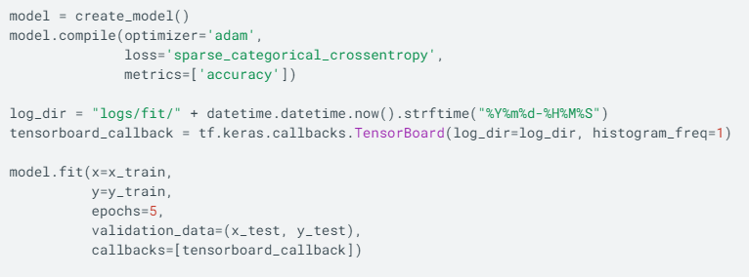
TensorBoard
visualization
TensorBoard provides the visualization and tooling needed for machine learning experimentation:
Tracking and visualizing metrics such as loss and accuracy
Visualizing the model graph (ops and layers)
Viewing histograms of weights, biases, or other tensors as they change over time
Projecting embeddings to a lower dimensional space
Displaying images, text, and audio data
Profiling TensorFlow programs
And much more
https://www.tensorflow.org/tensorboard/get_started

Slide 16
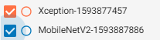
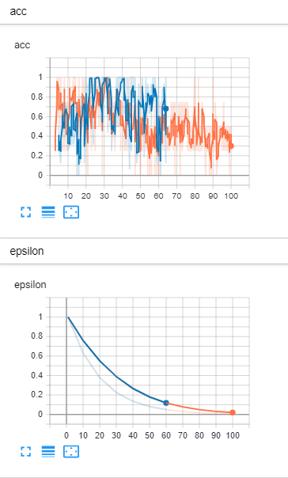
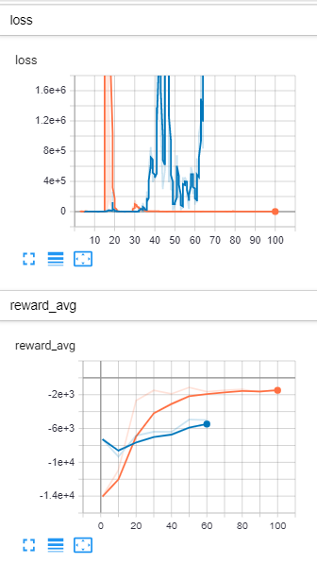
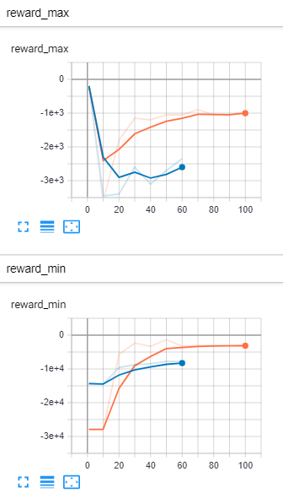
TensorBoard results
Notes:
Loss explosions at MobileNetV2 – which cause the car to rotate endlessly
Reward Max is not good at MobileNetV2, in the other hand Xception increase in healthy way
Acc at Mobile reach 1 - overfitting which isn’t good.

Slide 17
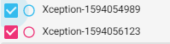
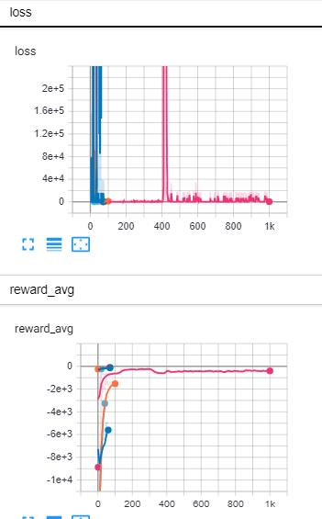
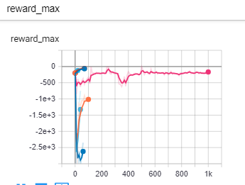
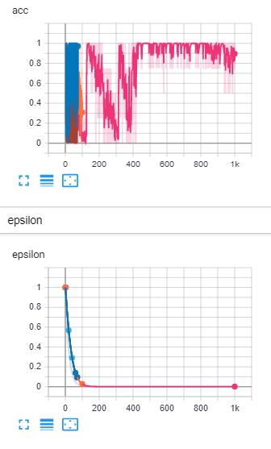
TensorBoard results ( 1000 episodes)
Notes:
Loss explosions at MobileNetV2 – which cause the car to rotate endlessly
Reward Max is not good at MobileNetV2, in the other hand Xception increase in healthy way
Acc at Mobile reach 1 - overfitting which isn’t good.

Slide 18
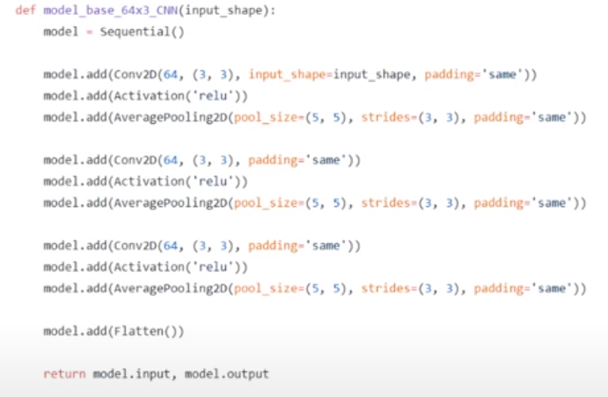
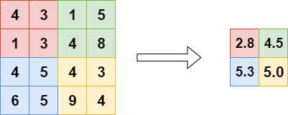
Simple Arciticture
IN DEPTH
3 layers of Conv2D + average pooling.

Slide 19
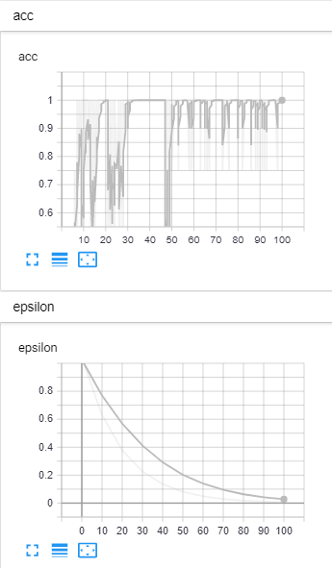
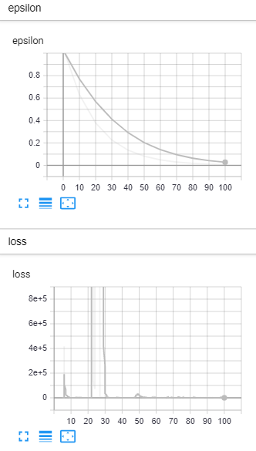
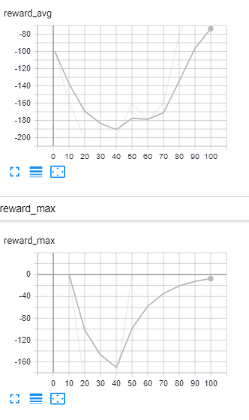
TensorBoard results
Notes:
Loss explosions at MobileNetV2 – which cause the car to rotate endlessly
Reward Max is not good at MobileNetV2, in the other hand Xception increase in healthy way
Acc at Mobile reach 1 - overfitting which isn’t good.

Slide 20
Show Time!
Agent In Action

